Slide 1
Spotify Music Mood
Eduardo Hernandez

Slide 2

What is Spotify
Spotify is a digital music, podcast and video streaming service that was launched in October 2008
It has a free and premium service that allows the client to listen music and create music.
It also gives a personal radio stations

Slide 3
Project Background /Method
It is a small scale of music, that is being streamed on spotify, that shows what mood music is being released
Used python to retrieve data and to be able to do data wrangling to be able to clarify the mood of the dataset.
Tableau was used to show the graphs and give a visualization of how mood is being affected in music

Slide 4
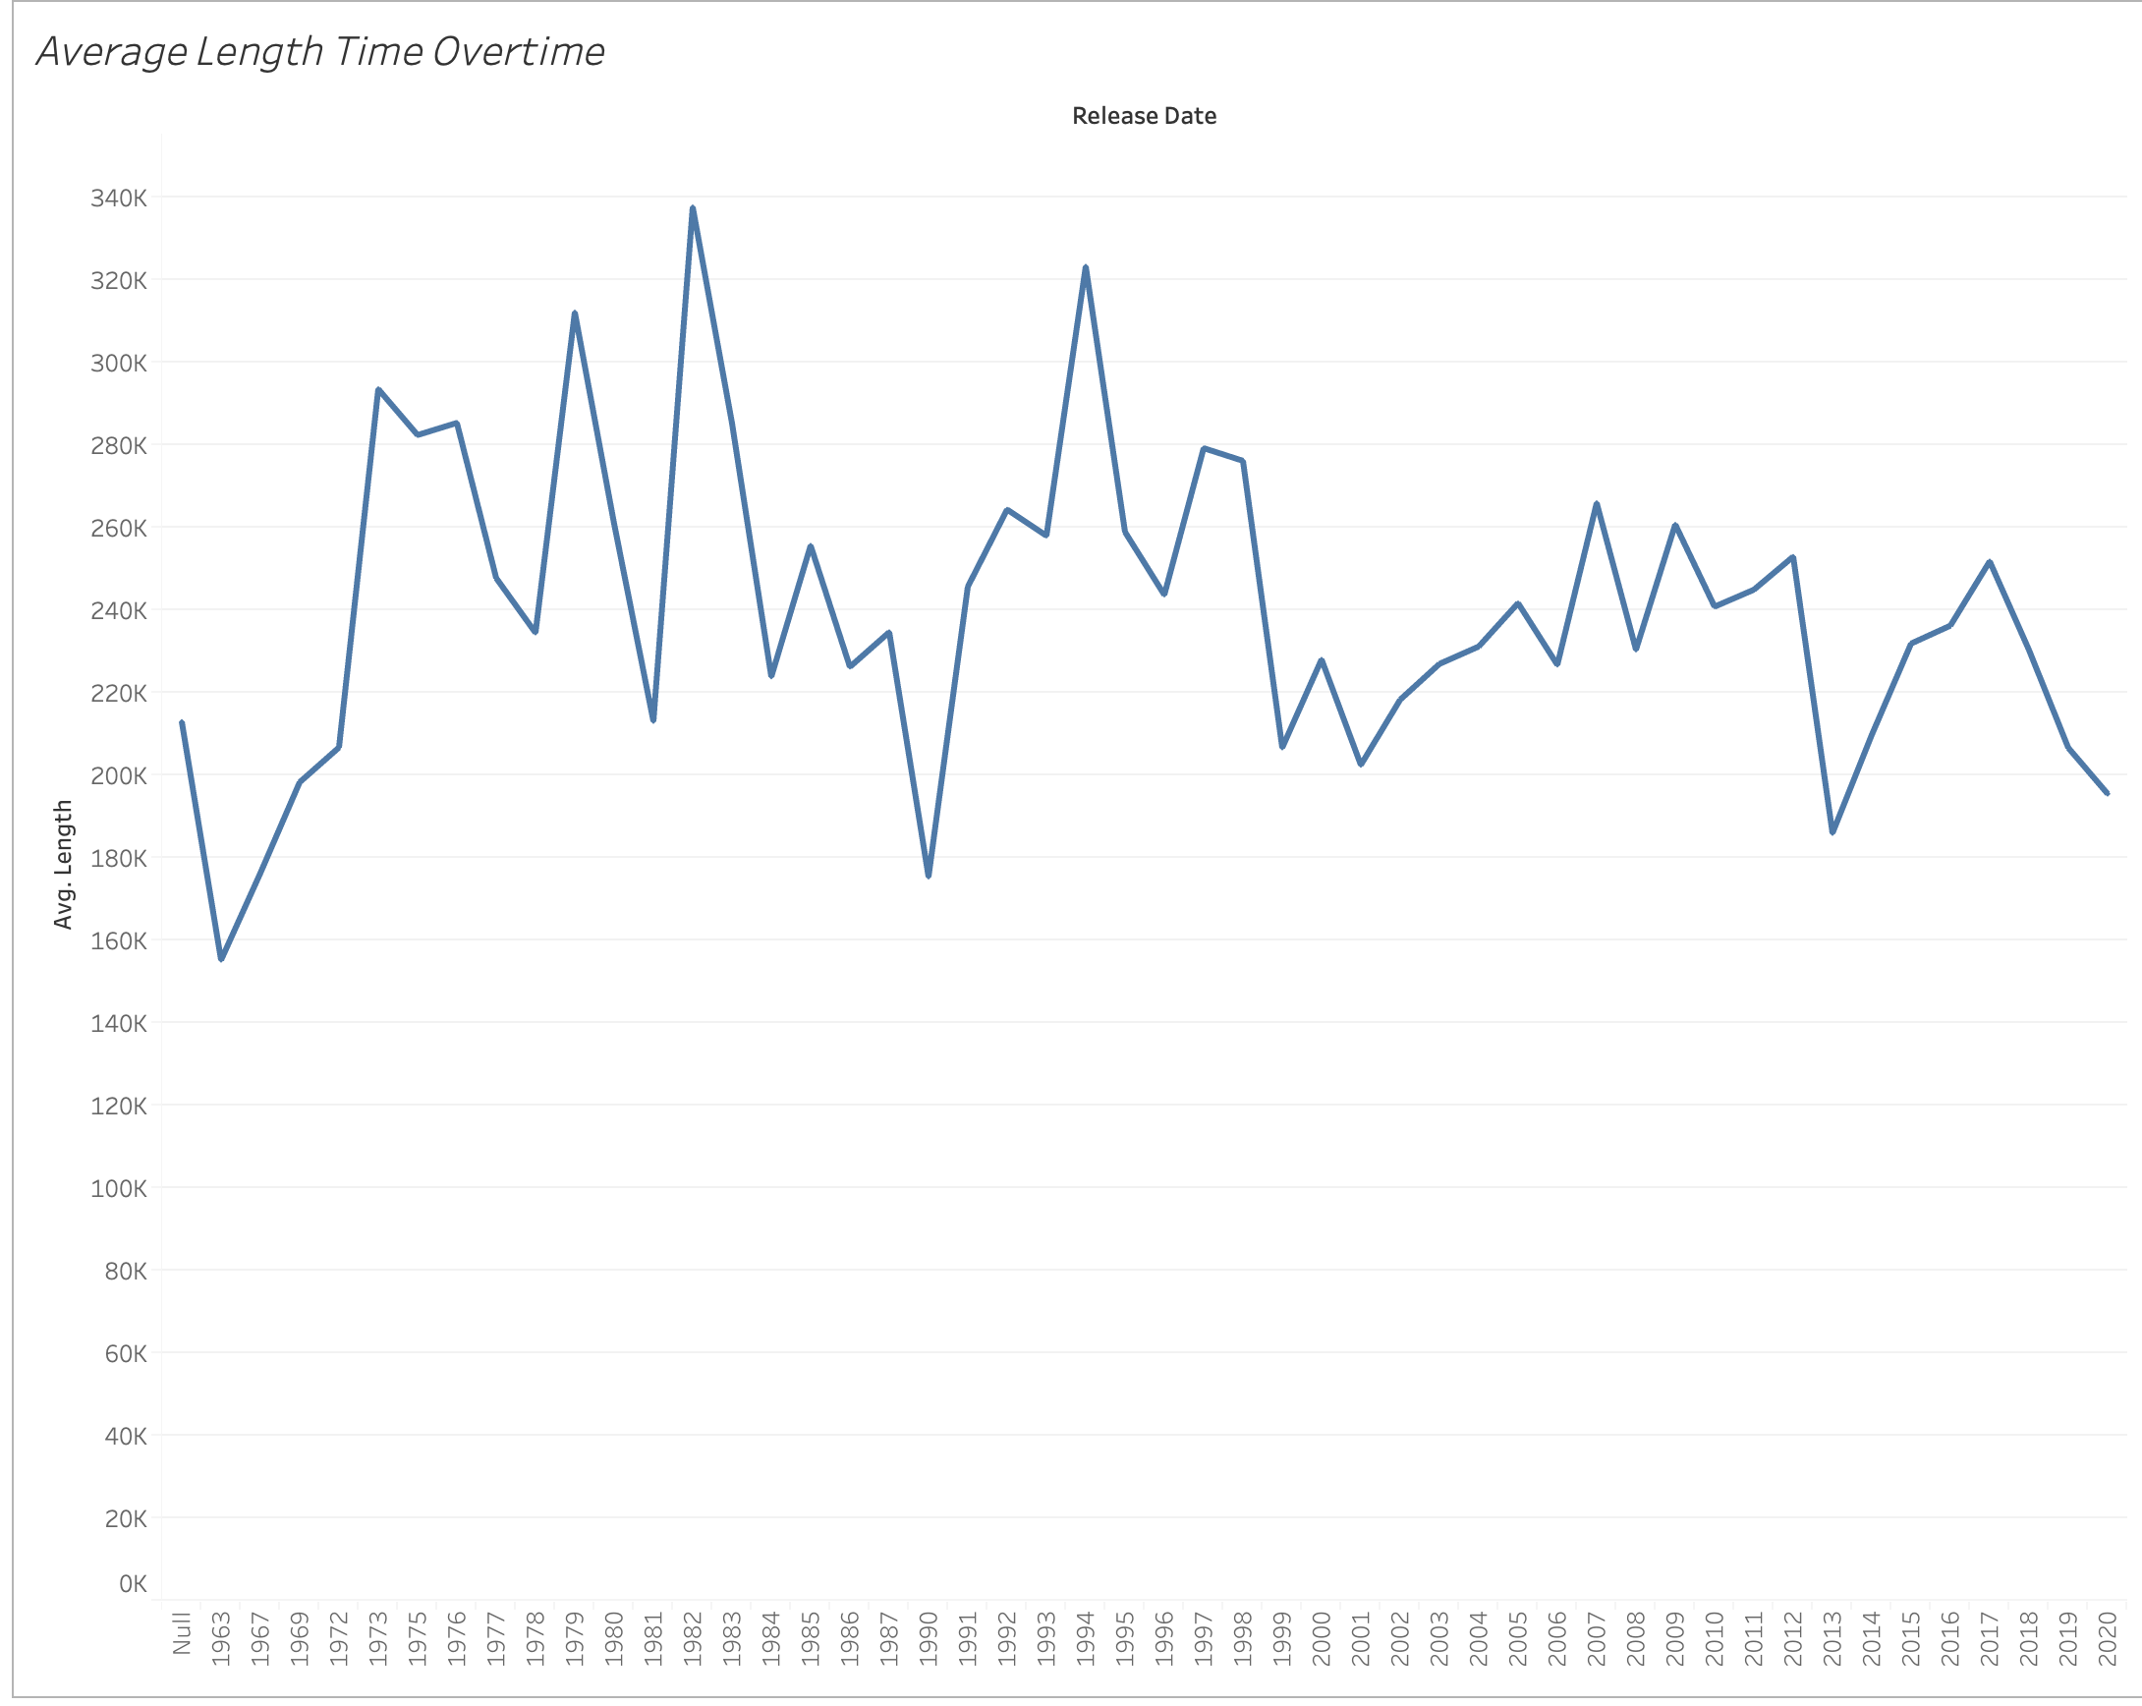

Slide 5
The average time for music
The highest of time average was in 1982 with 5.63 minutes (337,580 milliseconds)
With the lowest of 2.59 minutes (155,226 milliseconds) in
From starting in 1963 to 1994 there is a trend of music going longer
After 1994 to 2020, the average time of music started to go down that by 2020 music average time is 3.44 minutes (206,631 milliseconds)

Slide 6
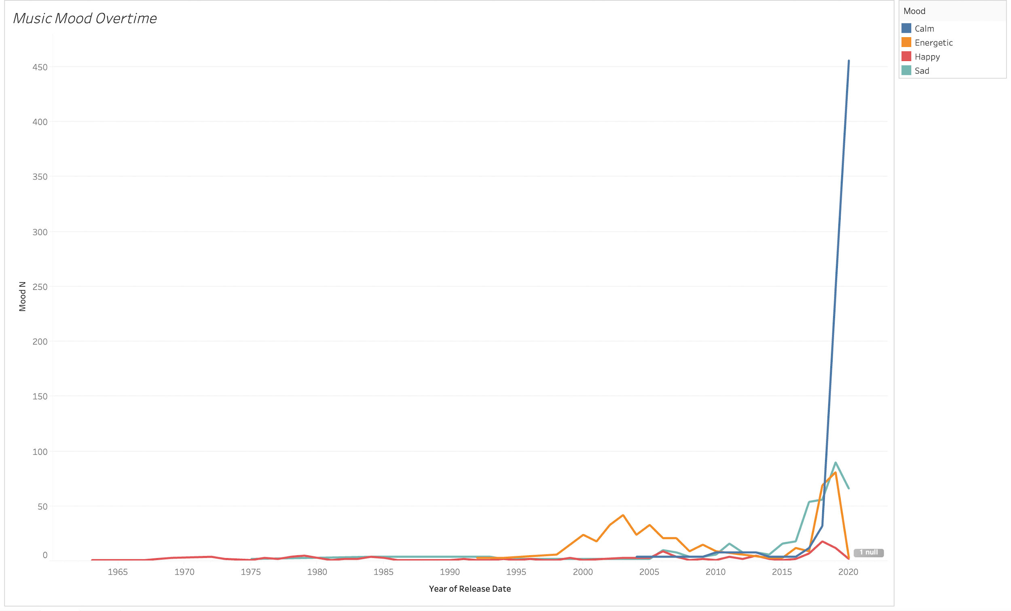

Slide 7
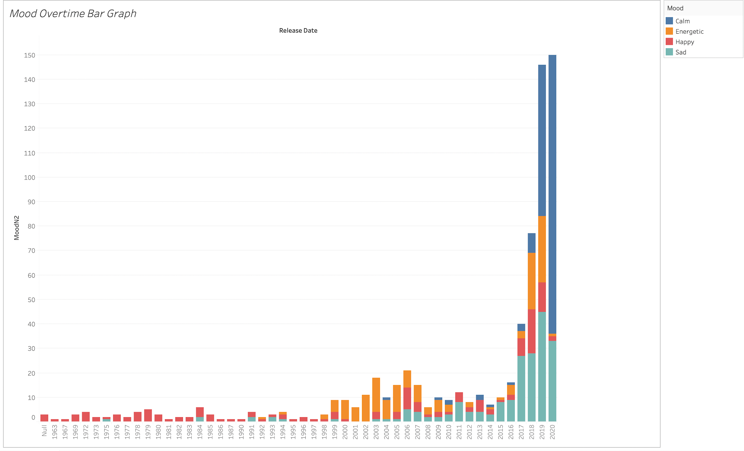

Slide 8
Trends of Mood
Starting in 1963, “Happy” music was being pushed out and was dominating.
By 2020, the most popular mood of music being released was “Calm” music

Slide 9
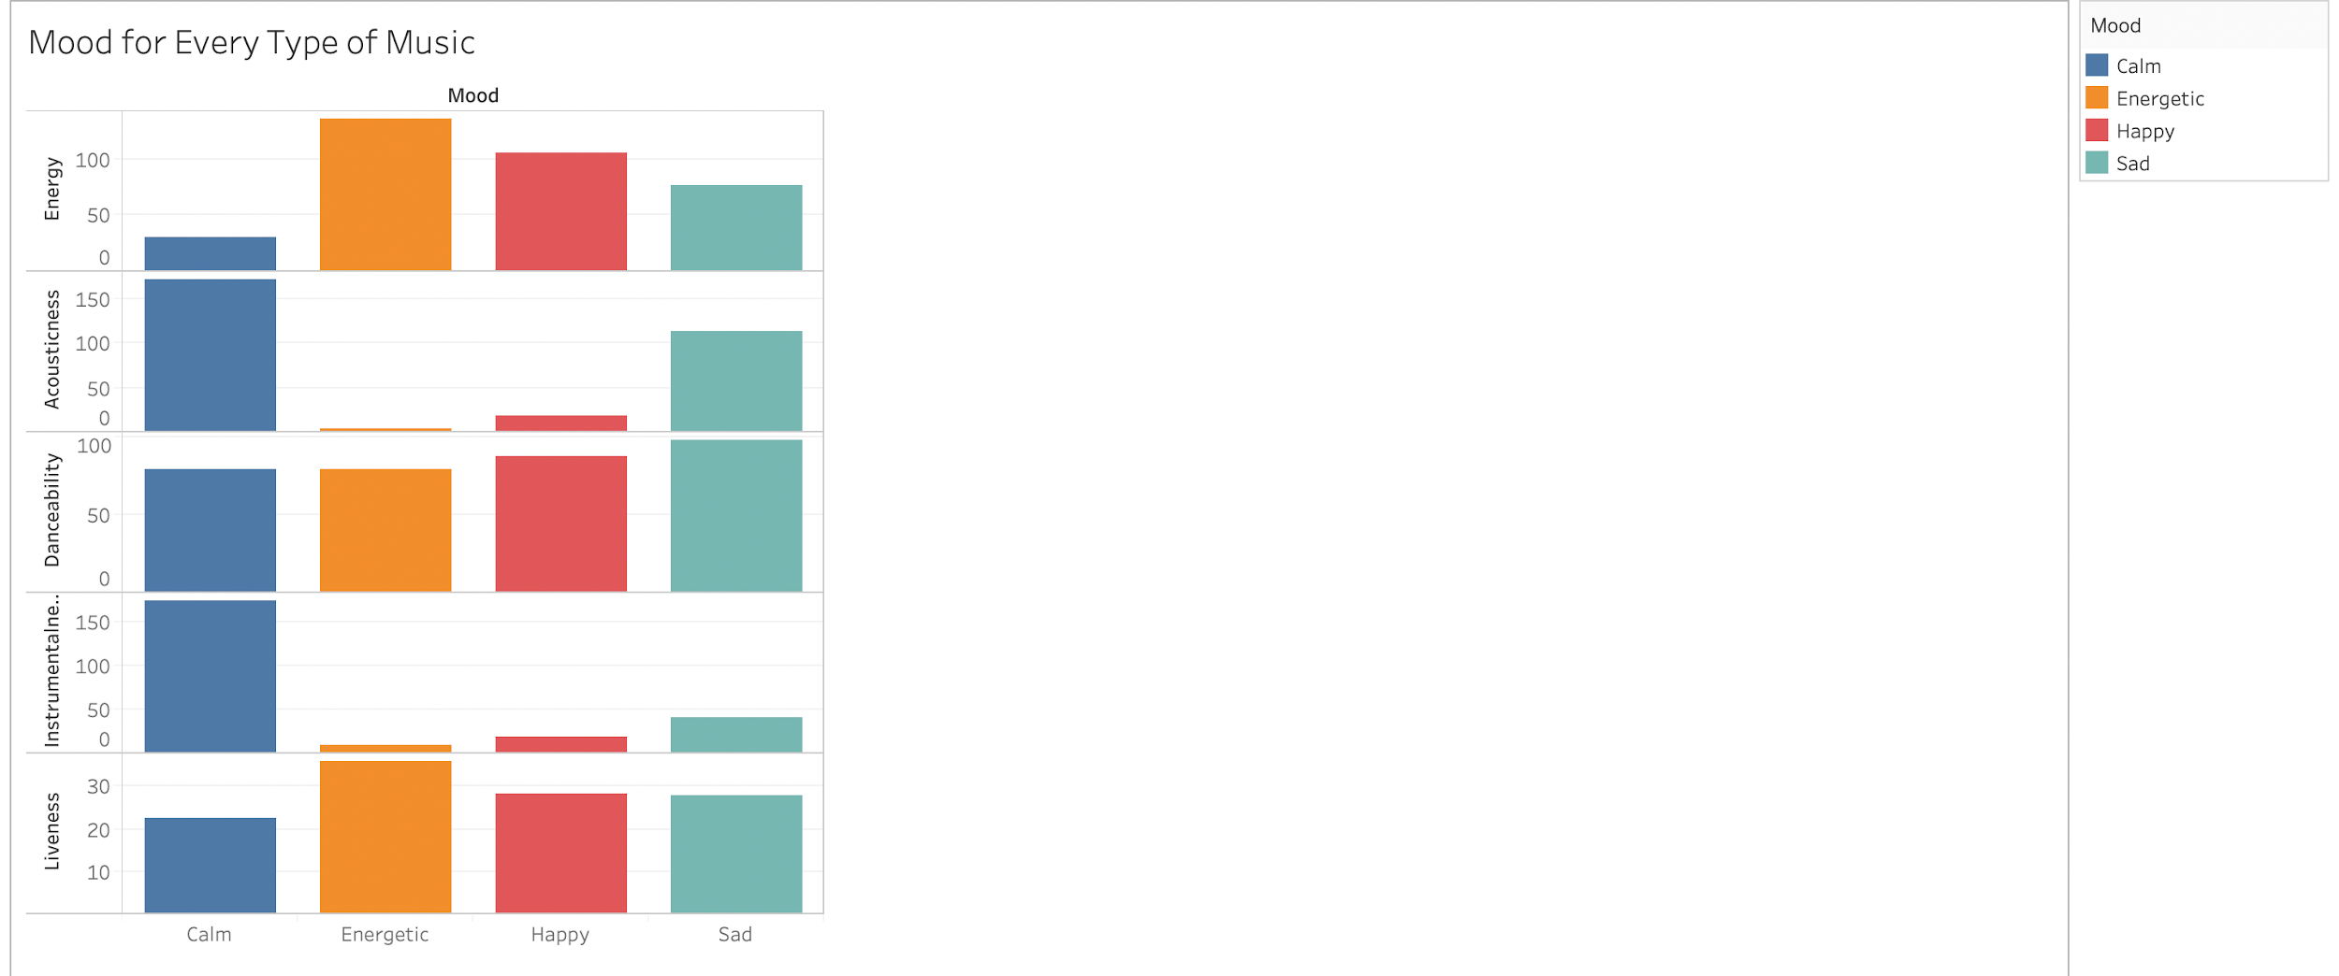
How was moods been used in every type of musics
The type of music being released are shown what type moods they want to reach out.
Liveness is using most of all four types of moods : Calm, Energetic, Happy and sad

Slide 10
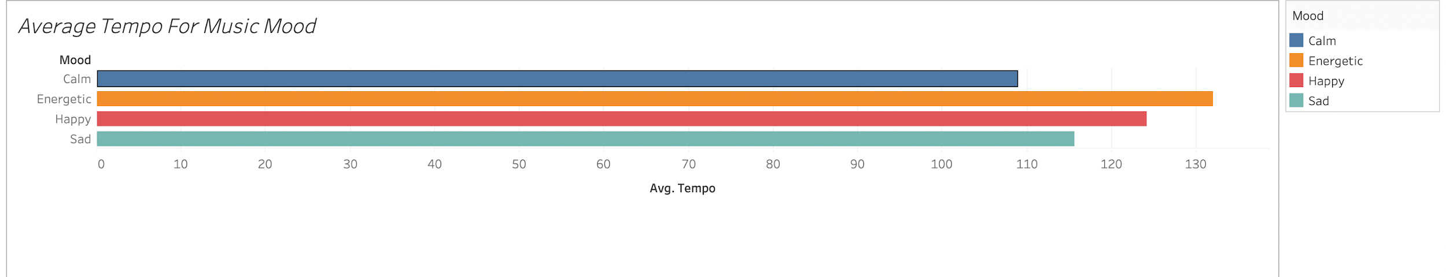
Has tempo affected the mood of music?
The tempo goes based on each mood the music is trying to reach.
With calm having the lowest tempo versus Happy having the highest tempo

Slide 11
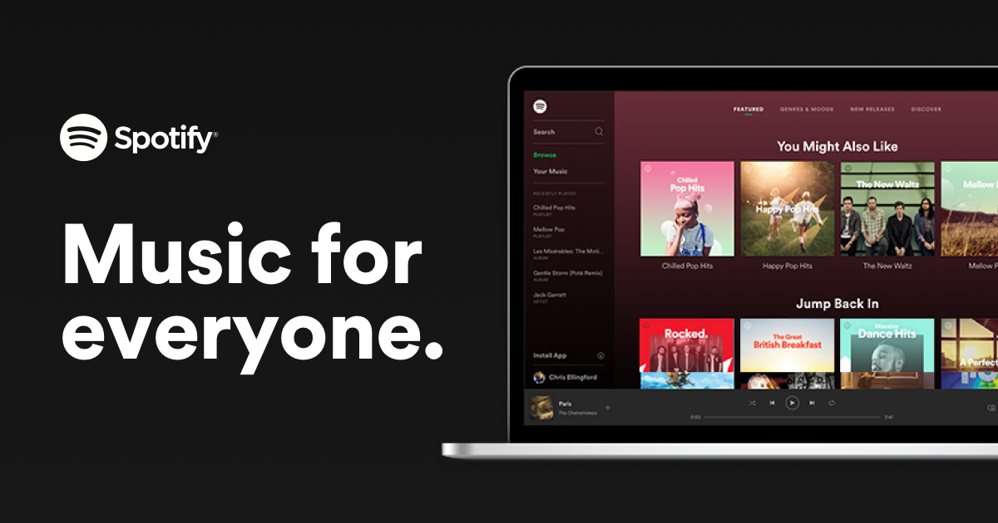
Summary
Tempo and the type of music that is being released on Spotify is affecting the mood of the song.
The audience is being reached out differently over time

Slide 12
Conclusion
The moods of music overtime change and ways that it's trying to reach out is being approached differently.
Using the genre, the tempo and the amount of time change and with different moods being introduced, artist change their types of music

